Slide 1

National research University «Higher school of Economics-Perm»
MEASURING SUCCESS IN EDUCATION
The work was performed by a 2nd year student: Chepokov E.S., Drozdov A.N., Yaroslavtsev D.
Perm’, 2019

Slide 2

Outline
Text
Perm, 2019
Чепоков Елизар Сергеевич
In title

Slide 3
research question
Text
Perm, 2019
Чепоков Елизар Сергеевич
In title

Slide 4
research question
Text
Perm, 2019
Чепоков Елизар Сергеевич
In title

Slide 5
Goals and objectives
Text
Perm, 2019
Чепоков Елизар Сергеевич
In title

Slide 6
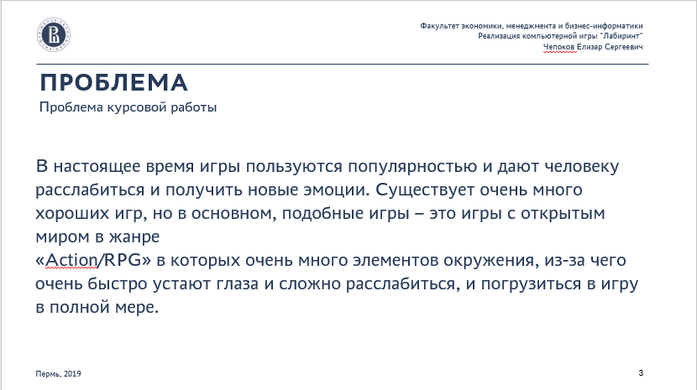
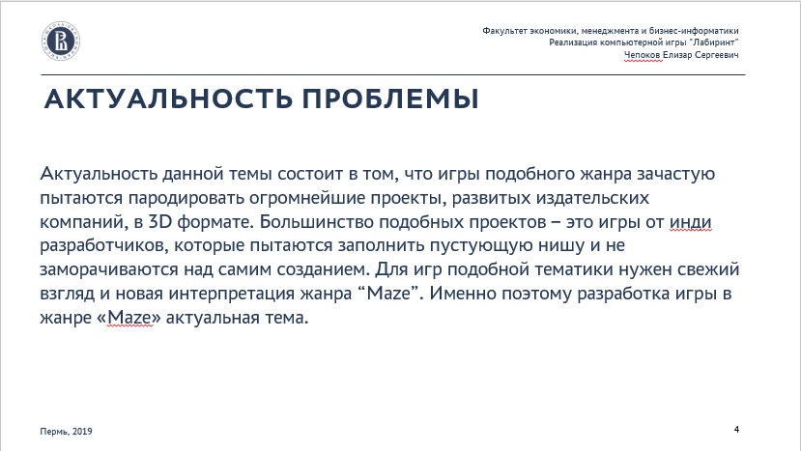
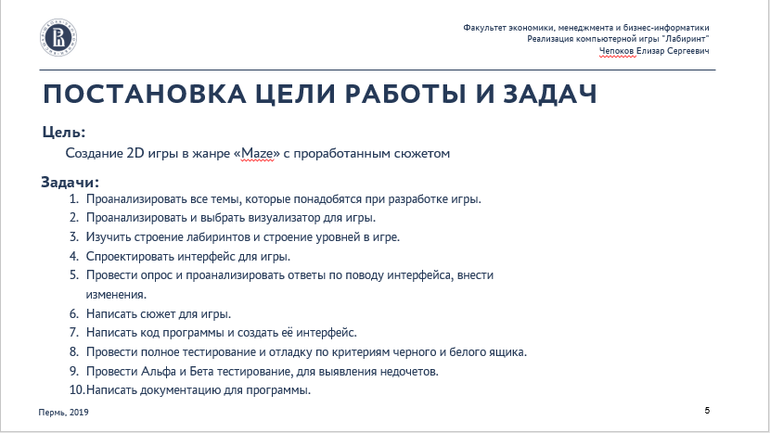





Contents list
3
4
5
6
7
8
9
10

Slide 7
THANK YOU FOR YOUR ATTENTION
WE ARE GLAD TO ANSWER YOUR QUESTIONS
Autor: Chepokov E. S.
Phone number: +7 (951) 959 4666
E-mail: eschepokov@edu.hse.ru

